Slide 1





DSA BOOTCAMP
CONDUCTED BY GDSC ICOER
Presenting by: Mohit Wat
TE (EnTC)

Slide 2


Till Now...
Programming Fundamentals: Variables, Conditions , Operators
Programming Fundamentals: Loops , Functions / Methods
OOP: Classes and Objects , Inheritance , Encapsulation
OOP: Polymorphism , Abstraction
What’s Next?
Algorithmic Complexities

Slide 3

Overview
What Is Complexity?
What Are Big-O Notations?
Types of Complexity
(Time Complexity and Space Complexity)
How can we measure Complexity ?
Notations used for analysis of Complexity
Syntax used for one type of complexity

Slide 4

What is Complexity?
Complexity in algorithms refers to the amount of resources (such as time or memory) required to solve a problem or perform a task.
In easy language, we can say that analysis of difficulty in the problem

Slide 5
Types of Complexity
(a) Time Complexity:
Time complexity is a function describing the amount of time an algorithm takes in terms of the amount of input to the algorithm.
Real-Life Example- (try to co-relate)
Teachers always said that we can write 4 as
1+1+1+1 / 2+2 / 4
Which of these sounds Simpler?

Slide 6
Types of Complexity (cont.)
(b) Space Complexity:
Space complexity is a function describing the amount of memory (space) an algorithm takes in terms of the amount of input to the algorithm.
Real-Life Example- (try to co-relate)
Google or Google Go. What will you prefer?
WhatsApp Desktop or WhatsApp Chrome (my preference)?
(My Hack)

Slide 7
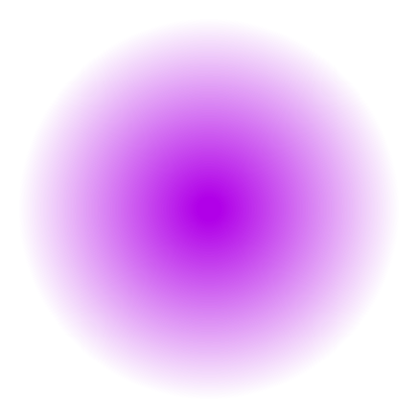
How can we measure Complexity?
Analysis of Cases
Best Case
Worst Case
Average Case
The Best Case scenario for an algorithm is the scenario in which the algorithm performs the minimum amount of work (e.g. takes the shortest amount of time, uses the least amount of memory, etc.).
The Worst Case scenario for an algorithm is the scenario in which the algorithm performs the maximum amount of work (e.g. takes the longest amount of time, uses the most amount of memory, etc.).
In Average Case analysis, we take all possible inputs and calculate the computing time for all of the inputs. Sum all the calculated values and divide the sum by the total number of inputs.

Slide 8
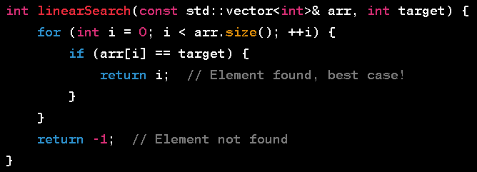
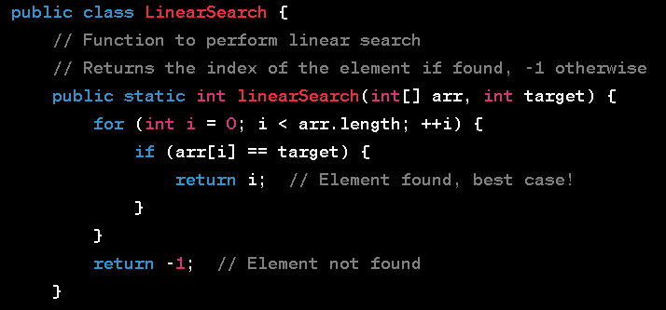
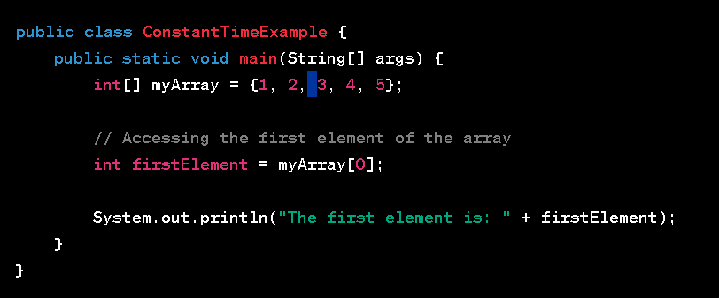
Syntax for Best Case Complexity:
C++ Syntax
Java Syntax
Python Syntax

Slide 9

Notations used for analysis of Complexity
Big-O Notation
O
We define an algorithm’s worst-case time complexity by using the Big-O notation. which determines the set of functions grows slower than or at the same rate as the expression
Omega Notation
Ω
It defines the best case of an algorithm’s time complexity, the Omega notation defines whether the set of functions will grow faster or at the same rate as the expression.
Theta Notation
θ
It defines the average case of an algorithm’s time complexity, the Theta notation defines when the set of functions lies in both O(expression) and Omega(expression), then Theta notation is
used.

Slide 10
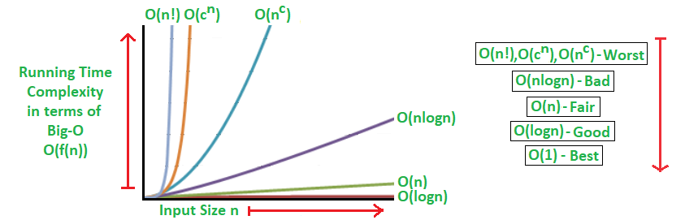
Graphical Representation of Cases

Slide 11


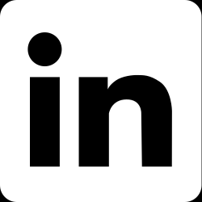
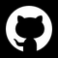
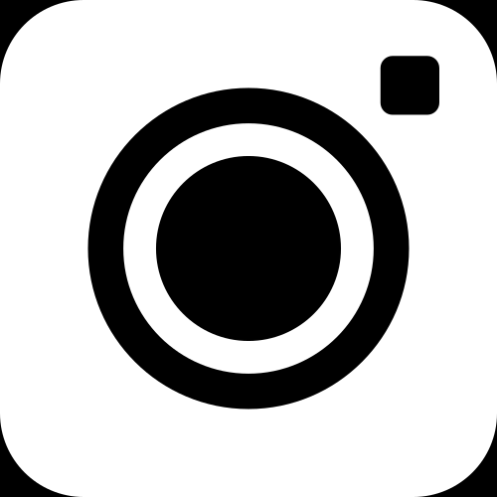
THANK YOU
For watching this presentation
+91 7796301657
mohitwatofficial@gmail.com
www.linkedin.com/in/mohit-wat-16b142255 | Mohit Wat
https://github.com/mohitwat7
@mohitwatzz

